Slide 1

Investment intelligence, engineered for precision.
Nxance tells every Indian investor whether their portfolio is actually working — and exactly how to fix it.
OHSHN INTELLIGENCE LLP · INVESTOR DECK · SEPTEMBER 2026
Notes:
Open with the one-line version: Nxance is the layer that tells an Indian investor whether the portfolio they already own is working, and what to do about it. Everything else in this deck follows from that sentence.

Slide 2
THE PROBLEM
Retail India invests blind, loses quietly, and has almost nowhere to turn.
21.6 Cr
9 in 10
< 1,000
demat accounts have been opened in India. Most are held by people with no professional view on what is inside them.
individual F&O traders lost money in FY25 — ₹1.06 lakh crore between them. Portfolios fail silently, for years.
SEBI-registered investment advisers serve 20+ crore investors — roughly one regulated adviser per two million people.
SEBI, Profit & Loss of Individual Traders in Equity F&O, Jul 2025
The Ken, SEBI-registered advisors are an endangered species, 2025
SEBI Depository Statistics, Dec 2025
Money is flowing in faster than advice can reach it. The gap is not capital — it is the absence of an honest, affordable second opinion.
Ohshn Intelligence LLP
02
Notes:
Three numbers, one point: enormous participation, poor outcomes, and no advice infrastructure. The adviser scarcity number is the one investors react to — lead with it if you are short on time.

Slide 3

WHY NOW
Payments and lending were rebuilt. Wealth intelligence was not.
Savings are moving into markets at record speed, and the tools that explain those markets have not moved with them. Language models make explainable, one-to-one analysis affordable for the first time.
$112B → $550B
~1 lakh a day
₹32,087 Cr
India's fintech market, 2024 to 2030
new demat accounts opened, on a base of 21.6 crore
monthly SIP inflows, up from ₹3,100 Cr in 2016
TechSci Research, India FinTech Market Report
AMFI, monthly SIP contribution, record high March 2026
SEBI Chairperson, IITF remarks, Nov 2025
Ohshn Intelligence LLP
03
Notes:
The timing argument is two-sided: demand is compounding (SIPs up 8x in a decade) and supply just became possible (LLMs make explanation cheap). Neither alone would justify building this in 2026.

Slide 4
THE SOLUTION
One app. Three engines.
Diagnose what you already own. Build what you should own instead. Have both explained to you in plain English or Hindi.
01 DIAGNOSE
02 REBUILD
03 EXPLAIN
Health Check
Construction
NxanceLM
Connect or upload what you hold. Nxance scores it out of 100 and tells you what is wrong, in rupees: hidden costs, hidden overlap, risk you did not agree to, and whether you will reach your goal.
Give it your goal, your horizon and how much loss you can live with. It returns a specific portfolio, a monthly amount, and the reason behind every holding it chose — and every one it rejected.
The layer that turns the other two into sentences, plus a live market terminal you can question directly. It never invents a number — it can only explain ones the engines computed.
Free to run. ₹99 to unlock the report.
Behind the subscription.
Every screen, English or Hindi.
Ohshn Intelligence LLP
04
Notes:
Keep this slide jargon-free — it is the one a generalist partner has to understand. The engineering proof comes two slides later. If asked "is this a GPT wrapper?", answer with the last line: the AI cannot produce a number, only explain one.

Slide 5
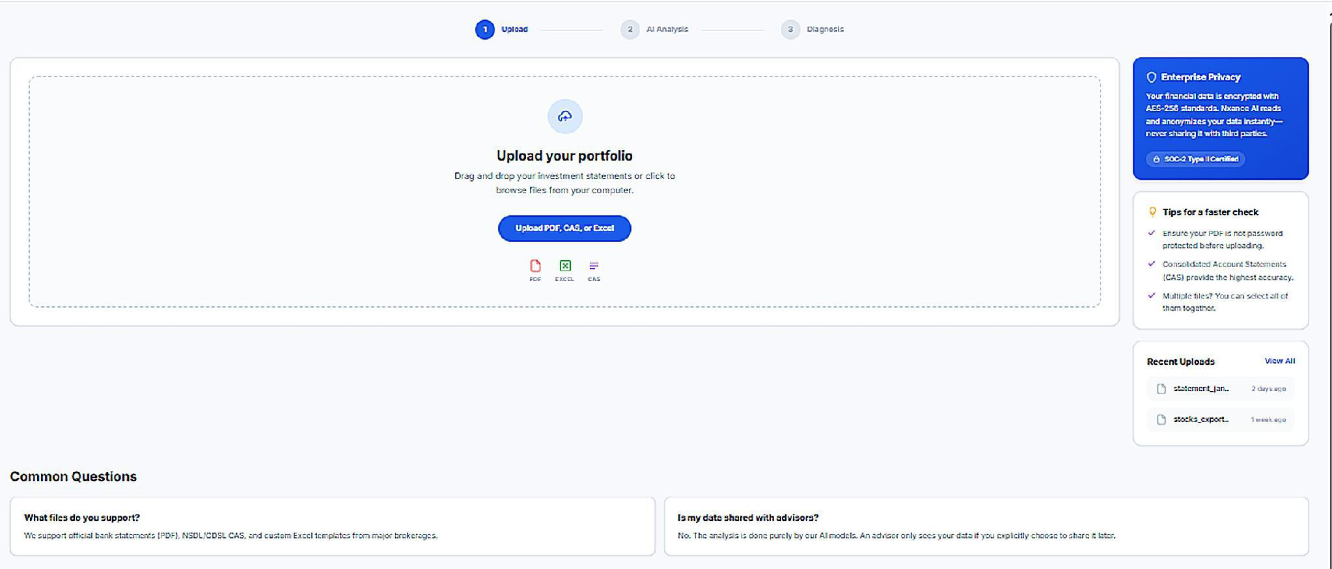
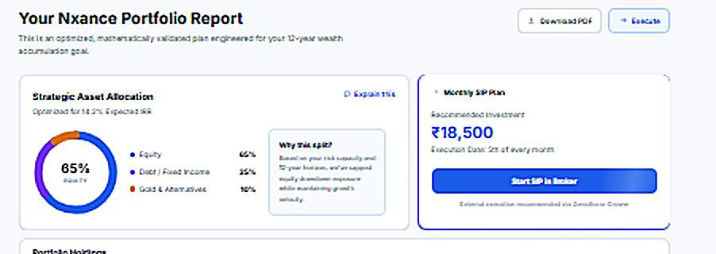
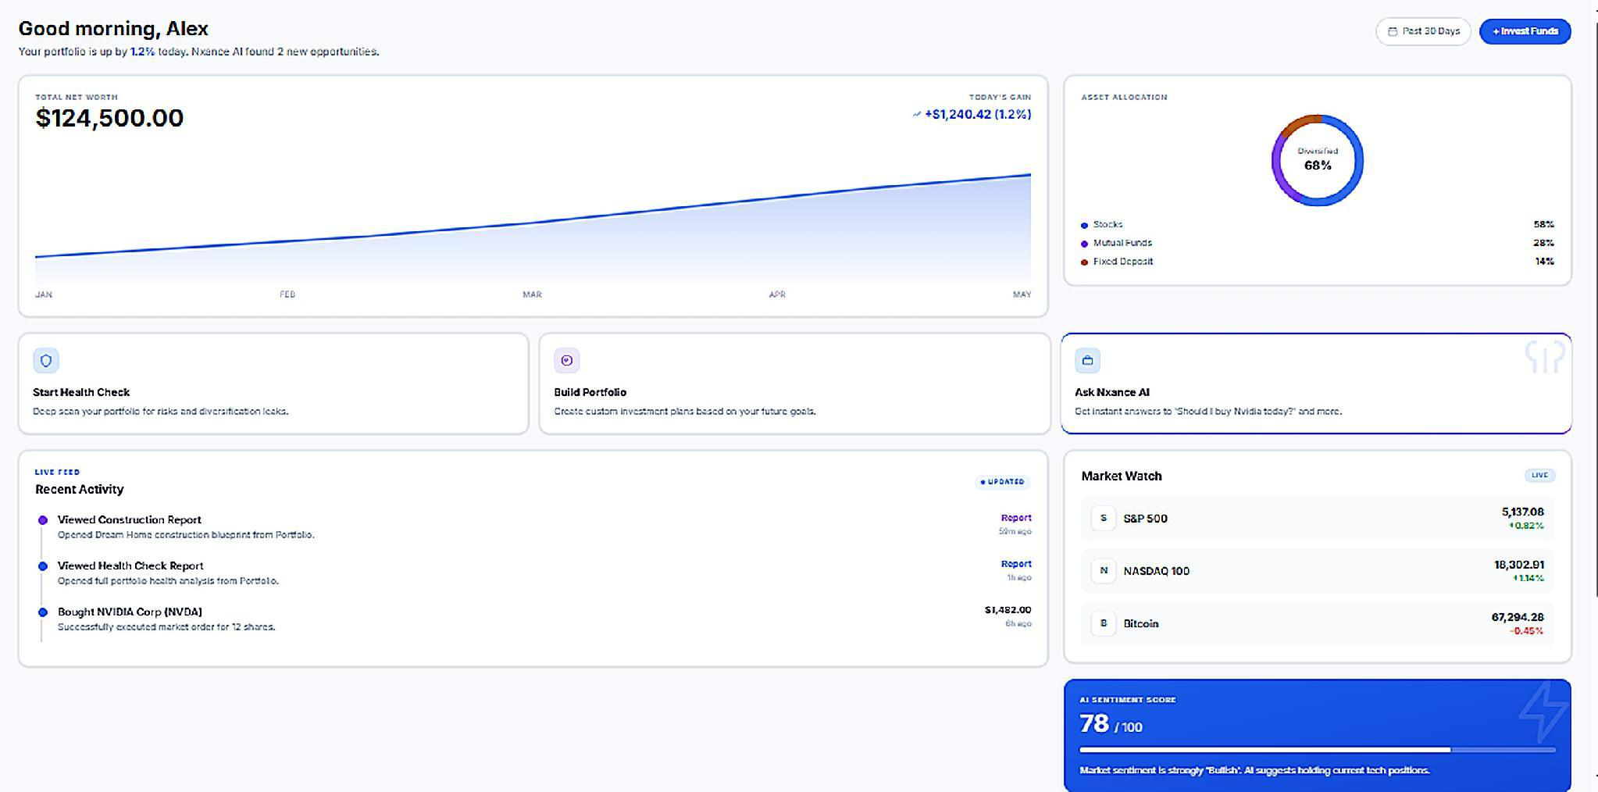
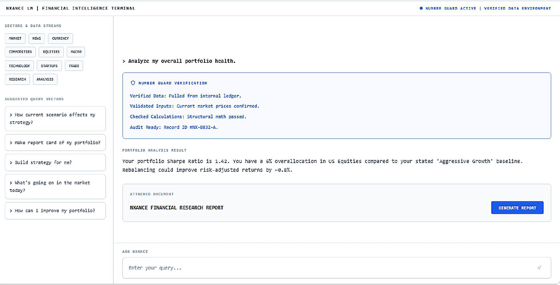
THE PRODUCT
Built and clickable today, across all three engines.
Health Check — upload a statement, get a diagnosis
Construction — an optimised plan, with the reasoning shown
Dashboard — net worth, allocation and sentiment in one view
NxanceLM — ask a question, see the verification behind it
Ohshn Intelligence LLP
05
Notes:
Offer the live demo here rather than walking the screenshots. The bottom-right shot is the one to point at: the Number Guard verification block is visible in the product, not just on a slide.

Slide 6
TECHNOLOGY
70 engines compute. The AI only explains.
HEALTH CHECK · 26
CONSTRUCTION · 26
NXANCELM · 18
XIRR, time-weighted returns
VaR, CVaR, Sharpe, Sortino
Maximum drawdown
Jaccard holdings overlap
Monte Carlo, 10,000 paths
Hidden Markov regimes
FinBERT news sentiment
Cost and fraud screens
Mean-variance optimisation
Black-Litterman views
Ledoit-Wolf shrinkage
Goal and drawdown limits
Every rejection recorded
Cost and fraud screens
VaR, CVaR, Sharpe on the mix
Monte Carlo goal probability
Results into English or Hindi
Answers on your own holdings
Writes report explanations
Live market and news terminal
Nxance Explain on any chart
NUMBER GUARD
STACK
Every figure must trace back to an engine output. Number Guard blocks any number the model was not handed — verified source, confirmed inputs, checked calculation, audit ID.
FastAPI · Supabase · Railway. Lean by design, sized for a subscription product.
Ohshn Intelligence LLP
06
Notes:
This is the one slide written for a technical reader — the vocabulary here is the point. Number Guard is the answer to the objection every AI-finance company gets: what stops it hallucinating a return figure?

Slide 7
WHY WE WIN
Diagnosis first. Reasoning shown. A flat fee.
Diagnosis before advice
Everyone else starts by selling you something new. Nxance starts with an honest read of what you already own — the cheapest way to earn the right to advise.
Explainable, not a black box
Every output carries its data, its method and its stated limits. Number Guard blocks any figure the engines did not compute, so the AI explains but never invents.
Subscription, not commission
A flat ₹399–1,499 a month. No cut of your assets, no trail commission, no lending cross-sell. Our revenue moves with your renewal, not your balance.
Broker- and asset-agnostic
Works across any broker and any asset class — not tied to one execution rail or a single model-portfolio format.
What makes it hold: answers stay tied to computed evidence; the product improves as consented, anonymised usage data compounds; and commission-free pricing is structurally hard for distributor-funded incumbents to copy, because trail commissions pay their bills.
Ohshn Intelligence LLP
07
Notes:
The bottom line answers "what happens when a foundation-model provider ships this?" — the defensibility is the incentive structure and the evidence trail, not the model itself.

Slide 8
COMPETITIVE LANDSCAPE
Nobody else starts with a diagnosis, shows its reasoning, and charges a flat fee.
 | Kalpi.ai | Wright Research | Ionic Wealth | MyFi | Nxance
Serves | DIY strategy builders | Managed money, RIA/PMS | HNI/UHNI, ₹1–25 Cr | Retail MF and stock investors | Every investor, first SIP to HNI
Pricing | Free, then premium tiers | ~1.5–2% of assets | PMS/AIF fees, accredited only | Free, monetised via lending | Flat ₹399–1,499 a month
AI depth | Rule-based builder | ML factor models | Insights on synced MF history | Chat over fund scores | 70 engines, every figure verified
Position | Systematic investing for DIY | AI robo-adviser | Angel One-backed, accredited | Review as a lending hook | Diagnosis-first, conflict-free
Dezerv (6 lakh+ users) is HNI-oriented, advisory-fee and relationship-manager-led — cited on the market slide as demand proof rather than as a direct comparable. Sources: company websites and public app listings, 2026.
Ohshn Intelligence LLP
08
Notes:
The row that matters is pricing. Three of the four charge a percentage of assets or monetise through lending, and both misalign the adviser with the investor. That is the wedge, not model quality.

Slide 9
MARKET
Sized as a fee pool, not a pile of assets.
Subscription, AUA or licensing — all three are revenue per rupee of assets influenced.
TAM · EVERY INSTRUMENT
SAM · ACTIVE MONEY ONLY
SOM · WHAT WE CAN COVER
₹68,500 Cr
₹41,200 Cr
₹165 Cr
a year · ~US$7.1 bn
a year · ~US$4.3 bn
ARR · ~US$17 mn
Every digitally held instrument an Indian can own — ₹80.3 L Cr in funds, ₹66.6 L Cr in listed equity, ₹11.3 L Cr in AIFs, REITs, InvITs and gold bonds — at 50 bps, 15 on treasury.
Dormant money stripped out. Only the 4.60 crore who actually transact, the trusts and investment companies already buying advice, and treasury a B2B motion can reach.
Coverage, not ambition: what the funded team and channels can serve by year five — 2.1 lakh subscribers, ₹33,000 Cr advised, or 66 licensees. 0.4% of SAM.
WHAT THE ₹158 LAKH CRORE IS INVESTED IN
Mutual funds ₹80.3
Listed equity ₹66.6
AIFs I–III ₹7.0
REITs, InvITs, SGBs ₹4.3
Amounts in ₹ lakh crore. NSE Ownership Tracker Q1 FY26 · AMFI Feb 2026 · SEBI · RBI. Promoter stakes, institutions and PMS excluded.
Ohshn Intelligence LLP
09
Notes:
Three different cuts of the same pool, deliberately. TAM answers what instruments exist. SAM answers whose money is actually live. SOM answers what we can physically cover. TAM by instrument, in rupees lakh crore: mutual funds of every category 80.3, which is 50.2 held by individuals and 30.2 of corporate treasury; direct listed equity 66.6, being 44.4 held by individuals and HUFs, 13.4 by trusts, LLPs and NRIs and 8.8 by non-promoter investment companies; AIFs across all three categories 7.0; and REITs, InvITs and sovereign gold bonds 4.3. SAM removes dormant money. India has 13.1 crore registered investors but only 4.60 crore who actually transact, so we count 55 per cent of the individual pool, not all of it. We keep 70 per cent of family vehicles, because trusts and investment companies are advice-seekers by construction though many sit with entrenched wealth managers, all of the alternatives, since nobody holds an AIF passively, and 40 per cent of corporate treasury, which needs a B2B motion rather than a consumer one. SOM is a coverage number, not a share-of-market aspiration. It is what the team and channels this raise funds can actually serve by year five, and it is reachable three separate ways, so the revenue does not depend on one pricing bet landing. Four pre-emptions. 50 bps is the low end of mutual-fund trail commissions, so we claim redirected spending, not new spending. Direct equity is the 9.6 per cent individuals hold outright, not the 18.5 per cent widely quoted, which already includes their mutual funds. PMS is excluded because Indian PMS holds securities in the client's own demat. Corporate treasury is carried at 15 bps, not 50, because cash advisory earns a fraction of portfolio advice. Still uncounted and real: non-government NPS, retail bonds through OBPPs, and overseas holdings via LRS.

Slide 10
BUSINESS MODEL
Free diagnosis, ₹99 to unlock it, then a subscription.
Tier | Price | What it opens
Health Check | Free | Run the diagnosis on holdings you already own
Full report unlock | ₹99 once | The complete report — a paid-intent qualifier, not the business
Starter | ₹399/mo | 2 portfolios, Health Check plus Construction, core engines
Growth | ₹899/mo | 2–5 portfolios, deeper engines, re-checks and rebalancing
Pro | ₹1,499/mo | 5–10 portfolios, all engines, full NxanceLM access
THE THIRD LAYER
OVER 18 MONTHS
HNI advisory fees and licensing the engines to distributors, once usage and behaviour data compound.
75 → 600 → 2,200 subscribers, ₹76.05 lakh collected — shown as upside, not netted off the ask.
Ohshn Intelligence LLP
10
Notes:
Be explicit that the 99-rupee unlock is a qualifier, not revenue — it separates curious users from paying ones before you spend on them. Subscription revenue is deliberately not netted against the ask.

Slide 11
GO TO MARKET
A free hook that converts into paid depth.
01
The free Health Check
The diagnosis is the acquisition. It costs nothing to run, surfaces a problem the user can see in rupees, and the ₹99 unlock turns curiosity into a first payment.
02
Performance marketing
Paid search and social aimed squarely at self-directed retail investors and recent demat-account holders, measured against unlock rate rather than installs.
03
Communities and educators
Telegram, Reddit and YouTube investing communities, plus partnerships with financial educators who already hold this audience's attention.
04
Distribution partnerships
Brokers, fintech apps and distributors as an embedded channel — opened only once the direct consumer product has proven it retains.
Ohshn Intelligence LLP
11
Notes:
Sequence matters here: 01 and 02 fund themselves, 03 lowers blended acquisition cost, 04 is deliberately gated behind retention proof so you are not negotiating from weakness.

Slide 12
WHERE WE ARE
“Everyone tells you to put your money to work. Nobody tells you how — or whether the money you have already put in is working.”
The same sentence, in one form or another, in almost every one of our first conversations. The engines exist because of it.
12
8 of 12
50
500+
investor and user conversations that pressure-tested the problem
said they would pay for an honest answer on their holdings
early users walked the working Construction engine end to end
users signed up to the pre-launch waitlist
BUILT
NEXT
ENTITY
A full clickable frontend across all three engines, demoed but not yet public.
The quant engines and the Number Guard layer — what this raise funds.
Ohshn Intelligence LLP, incorporated July 2026. Private Limited at close.
Ohshn Intelligence LLP
12
Notes:
Read the quote out loud, then pause. It does two jobs: it names the emotion the whole product sits on, and it splits the problem into the two questions Construction and Health Check answer. Then move to the numbers — but do not oversell them. Pre-revenue, small, honest: the frontend is built, the demand signal is real but early, and the backend is what the money is for.

Slide 13
18-MONTH ROADMAP
Six build phases. Three capital tranches.
Build phase | Months | What ships | Gate that must clear
Foundation | M1–3 | Portfolio import, health score | 100 interviews, 30–50 testers
Alpha | M4–6 | Risk profiling, Monte Carlo | 100+ analyses, 40% repeat use
Closed beta | M7–9 | Payments, model monitoring | 300–500 users, 25–50 paying
Public V1 | M10–12 | Production build and reporting | 1,000+ users, early revenue
Simulation | M13–15 | Market replay, stress tests | Validated scenario library
Institutional | M16–18 | Adviser platform, APIs | 3 institutional pilots, 5,000 users
CAPITAL RELEASES ON ITS OWN CLOCK — THREE TRANCHES, 6 MONTHS EACH
Tranche 1 · M1–6
Tranche 2 · M7–12
Tranche 3 · M13–18
₹2.74 Cr
₹5.27 Cr
₹4.48 Cr
+6% equity
+7% equity
+7% — 20% in total
Capital and equity release together, only once the prior tranche's deliverables are evidenced. Tranche 2 carries the SEBI-RIA deposit and the full ₹1.33 Cr contingency, which the round closes with intact. Tile widths show each tranche's share of the round.
Ohshn Intelligence LLP
13
Notes:
Two clocks, deliberately. The product ships in six 3-month phases; capital releases in three 6-month tranches. They do not line up, and that is the point: an investor is not funding a phase, they are funding a checkpoint. Tranche 1 funds exactly the first six months of burn. Tranche 2 is the largest because it carries the SEBI-RIA deposit and the whole contingency. Tranche 3 funds the last six months at a lower monthly rate because the buffer is already in hand. Equity releases with the capital: 6%, then 7%, then 7%, reaching 20% only if all three are drawn. The Simulation gate also carries two design partners in the milestone model; the slide leads with the validated scenario library because that is the artefact an investor can actually be shown.

Slide 14
TEAM
Four founders, full-time, one product.
Abhishek Rajput Founder & CEO
Raghav Kripasthya Co-Founder & CTO
Investment analyst and product builder. Trades equity and derivatives, has run live portfolios, and has built sales teams that beat target.
AI engineer and data scientist. Has shipped intelligent systems across healthcare, defence and computer vision. Python, PyTorch, AWS.
Deepesh Khemka Co-Founder & CIO
Bhaskar Pandey Co-Founder & COO
CFA Level III (charter pending) with deep capital-markets expertise. Built and scaled businesses before moving into wealth management.
Technology strategist across AI/ML, enterprise automation and data platforms. Has shipped 28+ npm packages for AI tooling.
40
25
₹5.83 Cr
43%
people at exit headcount
costed hiring lines in the budget
budgeted people cost over 18 months
of that pool is investment and research
Ohshn Intelligence LLP
14
Notes:
The full 25-line hiring schedule with start months sits in the budget model. The point of the bottom strip is that 43% of people spend goes to investment and research — this is a research company with an app, not an app with a finance feature.

Slide 15
THE ASK
₹12.49 Cr for 20% — ₹49.95 Cr pre-money.
₹12.49 Cr
18 months
₹62.44 Cr
Operating burn, SEBI-RIA deposit and contingency
of runway, backend build to institutional pilots
post-money, investor ownership at close 20.0%
WHERE IT GOES
Building and growing 72.6% · ₹9.06 Cr
Running and protecting 27.4% · ₹3.41 Cr
Technology & AI
27.7% ₹3.45 Cr
Founder draws
7.6% ₹0.95 Cr
Investment & research
23.6% ₹2.95 Cr
Organisation & office
6.1% ₹0.76 Cr
Marketing & brand
17.1% ₹2.14 Cr
Compliance & insurance
3.0% ₹0.37 Cr
Sales & support
4.2% ₹0.52 Cr
Contingency reserve
10.7% ₹1.33 Cr
₹11.10 Cr operating burn + ₹1.33 Cr contingency + ₹5 lakh refundable SEBI-RIA deposit = ₹12.49 Cr. Bars are scaled to the largest line. Projected subscription revenue of ₹0.76 Cr is upside, not netted against the ask.
Ohshn Intelligence LLP
15
Notes:
The split is the point: just under three quarters of the round goes into building the product and reaching users, and only 16.7% into running the company. Founder draws are 7.6%. If an investor pushes on the contingency, it is 12% of operating burn and it is the reason the round still closes with cash in hand.

Slide 16
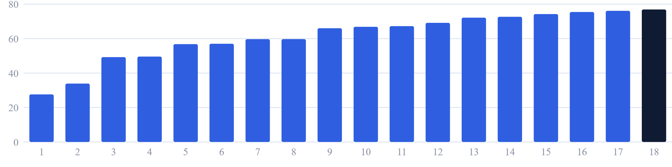
FINANCIAL PLAN
Burn ramps with the build, not ahead of it.
Monthly operating cash use, ₹ lakh, Month 1 to Month 18
₹27.6L
₹61.97L
₹76.91L
₹11.10 Cr
Month 1, before the team scales
average monthly burn over 18 months
peak, in Month 18 at full headcount
total 18-month operating requirement
Ohshn Intelligence LLP
16
Notes:
The shape is the argument: spend follows hiring, and hiring follows the gates on the roadmap slide. There is no step change at launch because marketing ramps gradually rather than in one burst.

Slide 17





EXIT ROUTES
Four acquisition routes. One path to listing.
The engines can be licensed as readily as they are used — which keeps more than one route open.
Strategic acquisition
Wealthtech consolidation
Brokers, AMCs and banks already own the customer relationship that Nxance makes stickier.
An established advisory or wealthtech platform acquiring the engines and the user base.
Infrastructure buyer
Secondary sale
An AMC, insurer or bank taking the engines as the intelligence layer behind its own product.
Early investors taking partial or full liquidity in a later growth round.
The long path: IPO
SEBI-RIA registration, then a scaled advisory book, then a public listing.
Ohshn Intelligence LLP
17
Notes:
Routes, not returns. At seed stage, naming the buyers matters more than modelling the multiple, and an investor who knows the category will do their own arithmetic. The line that earns the slide is the one under the heading: because the engines can be licensed as well as used, an infrastructure sale stays open even if the consumer product plateaus. If pushed on numbers, say the exit sensitivities exist in the model and offer to walk through them separately.

Slide 18
THE VISION
Every rupee, properly understood.
Become the intelligence layer behind India's financialising wealth — the one place any investor, from first SIP to HNI, goes to find out whether their money is actually working.
NXANCE.COM · OHSHN INTELLIGENCE LLP
Notes:
Close on the vision line, then go straight to the ask in conversation rather than re-presenting it. If there is time for one demo, make it the Health Check on the investor's own portfolio.

